Slide 1

Project Title – Netflix Movie and Show Analysis PowerBI Dashboard
Name- Abhishek Shukla

Slide 2

PROBLEM STATEMENT
This Power BI dashboard aims to provide a comprehensive overview of Netflix's content library, focusing on key performance indicators such as IMDb scores, TMDb scores, and user votes. By analyzing these metrics, the dashboard helps identify trends, high-performing content, and user preferences. It also offers insights into content distribution by runtime, genres, age ratings, and production countries, aiding in strategic decision-making for content acquisition, production, and recommendation algorithms.

Slide 3
Project Description
I analysed the data in the dataset and tried to make as many useful insights out of it .
Shows a pie chart of No of shows per season
Has a column chart of runtime grouped by in 30mins interval to their IMDB rating so as to know what is the preferred runtime by the Audience
Used a DAX Query to create a new column out of runtime to group it into 30mins ranges
Contains Horizontal Bar chart to show which age rating is generally preferred
Contains area chart to show how by time number of shows have increased.
Compares number of Movies v/s Shows in a donut chart.
Shows no of shows produced per country in World map.
Presents most voted show and movie respectively by audience

Slide 4

WHO ARE THE END USERS?
Content Strategists: To identify high-performing genres and production countries and make informed decisions on content acquisition and production.
Marketing Teams: To understand user preferences and engagement metrics, aiding in targeted marketing campaigns.
Data Analysts: To analyze trends and patterns in user ratings and content distribution for deeper insights.
Product Managers: To enhance user experience by leveraging insights for improving recommendation algorithms and content curation.
Executive Management: To gain a high-level overview of content performance and strategic insights for business decisions.

Slide 5

Technology Used
POWERBI
DAX QUERY
EXCEL(CSV)
KAGGLE Database - https://www.kaggle.com/datasets/victorsoeiro/netflix-tv-shows-and-movies/code

Slide 6
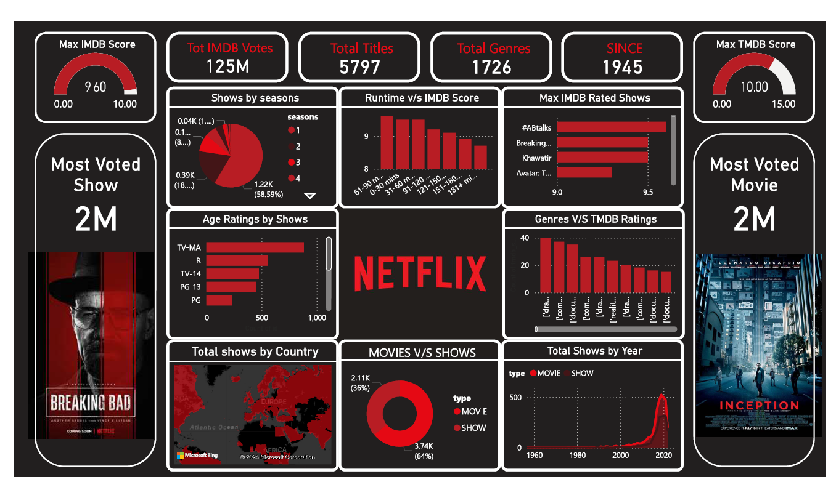
RESULTS
Pdf screenshot:
Github link : https://github.com/abhiabhishek19/Netflix-Dashboard-PowerBI

Slide 7
Thank you
.
.

